Slide 1

Project Title: Behavioral Finance Patterns in Predicting Global Financial Crises: An Analytical Approach to Crisis Forecasting
Domain: Economics & Finance
First Review
Course Code: CS6510
Course Title: Project 1
Register Number: 23MSP3068
Name: Dharshani A.
Date: 27-11-2023

Slide 2
Problem Statement
Traditional economic forecasting methods lack the finesse to predict financial crises accurately, missing complex and seasonal trends.
This study proposes a novel model integrating SARIMAX, for its strength in seasonal analysis, with Neural Networks, adept at uncovering non-linear patterns.
Incorporating LSTM into predictive analytics to capture sequential dependencies and time-series predictions.
Aimed at equipping policymakers with timely, actionable insights, this hybrid approach seeks to enhance the precision of crisis prediction, ensuring robust economic defense strategies.

Slide 3
Objectives
To perform data preprocessing and exploratory data analysis of the appropriate datatset
To design a model that integrates the SARIMAX method for its strength in analyzing seasonal trends.
To implement LSTM networks to investigate and model complex temporal dependencies in economic time-series data.
To develop a hybrid approach that combines the benefits of machine learning and econometric models for improved prediction accuracy.
To conduct a comparative analysis of hybrid models against traditional forecasting techniques.

Slide 4
Review of Related Literature
Title of the Paper | Authors | Journal Name/ Conference Title & Publisher | Year of Publication | Methodology used | Performance of the proposed algorithm | Limitations of the Research | Future approach if any
2018 Financial Risk and Regulation Survey: Behavioral Finance & Financial Stability | Harvard Business School | Harvard Business School | 2018 | The study employed a combination of regression analysis, econometric methods, and possibly modern machine learning techniques, given its focus on understanding and forecasting financial downturns. | The study focuses on the analysis of financial risks such as asset price inflation and high debt, contributing to a better understanding of financial instabilities. | Potential limitation in integrating traditional and modern techniques effectively. | The study can be expanded with traditional time series analysis, including ARIMA models, with advanced machine learning techniques, to discern cyclical patterns and complex interactions among various economic factors
Previous studies have focused on ARIMA models for economic forecasting, but they fall short in handling complex, non-linear patterns.
Recent advancements in machine learning, particularly Neural Networks, have shown potential in financial applications.
This research builds upon these findings, proposing a novel integration of SARIMAX and LSTM Neural Networks.

Slide 5
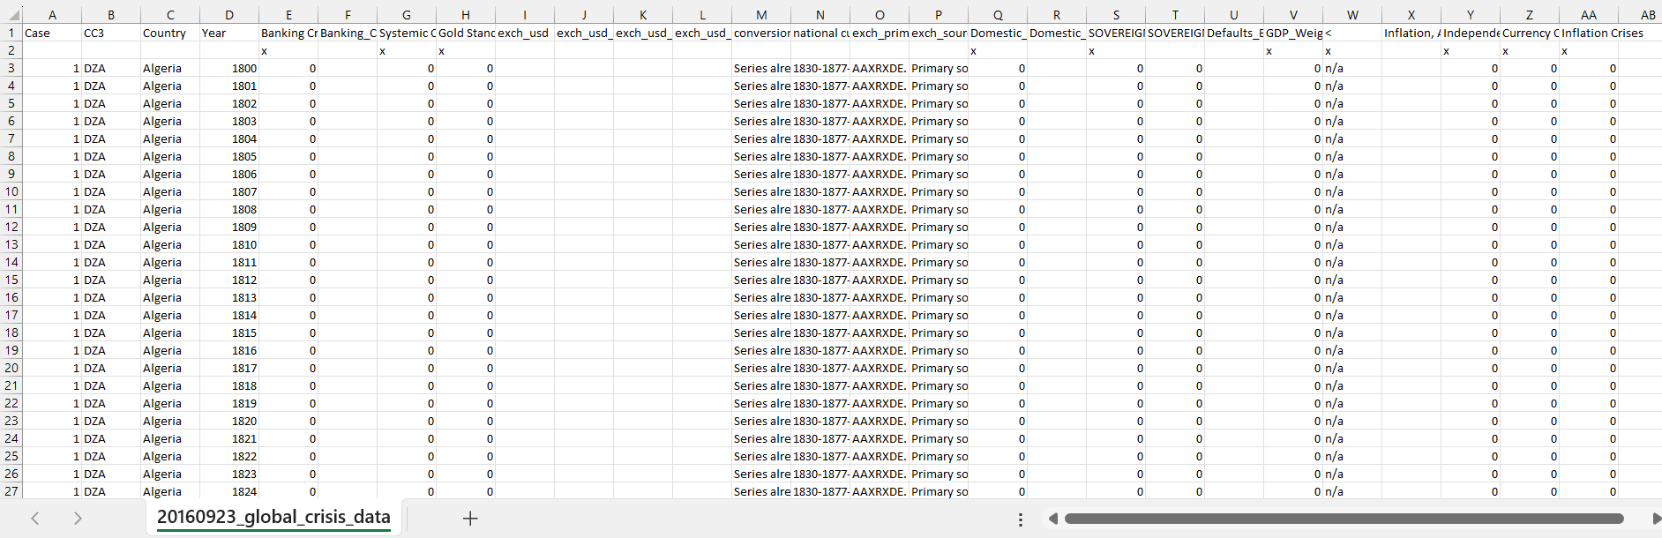
Dataset
Source of the Dataset: Global Financial Crisis Analytics | Kaggle
No. of Observations: 15,192
Screenshot of the dataset
CS6501 Project I PGP, ICER, VIT Bangalore
5

Slide 6
Column/Feature Details of the Dataset
1. Case: A numeric identifier for each record. Each country appears to have a unique case number.
2. CC3: The three-letter country code, following the standard ISO alpha-3 country codes.
3. Country: The name of the country to which the data row corresponds.
4. Year: The year for which the data is recorded.
5. Banking Crisis: Indicates the occurrence of a banking crisis. '0' indicates no crisis, while '1’ indicates a crisis.
6. Banking_Crisis_Notes: Additional notes or explanations about the banking crisis, if any.
7. Systemic Crisis: Indicates whether a systemic crisis occurred in that year. Similar to 'Banking Crisis', '0' likely means no systemic crisis.
8. Gold Standard: Indicates whether the country was on the gold standard in that year.
9. exch_usd: The exchange rate of the country's currency to the US dollar.
10. exch_usd_alt1, exch_usd_alt2, exch_usd_alt3: Alternative exchange rate values, representing different sources or calculation methods.
11. Conversion to USD notes/sources: Notes or sources for the exchange rate data.

Slide 7
Column/Feature Details of the Dataset (continued)
12. Domestic Debt In Default: Indicates whether there was a default on domestic debt.
13. Domestic_Debt_ Notes/Sources: Notes or sources regarding the domestic debt data.
14. SOVEREIGN EXTERNAL DEBT 1 and 2: Indicates whether there was a default or restructuring of sovereign external debt. Different columns might represent different categorizations or time periods of the debt.
15. Defaults_External_Notes: Notes about external debt defaults.
16. GDP_Weighted_default: A measure of defaults weighted by GDP, possibly indicating the severity or impact of the default relative to the country's economy.
17. Inflation, Annual percentages of average consumer prices: The annual inflation rate, measured as the percentage change in consumer prices.
18. Independence: Indicates whether the country was independent in that year.
19. Currency Crises: Indicates the occurrence of a currency crisis.
20. Inflation Crises: Indicates the occurrence of an inflation crisis.

Slide 8
Details about the columns
Categorical Columns:
CC3, Country, Banking Crisis, Banking_Crisis_Notes, Systemic Crisis, Gold Standard, exch_usd, exch_usd_alt2, exch_usd_alt3, conversion_notes, national currency, exch_primary source code, exch_sources, Domestic_Debt_In_Default, Domestic_Debt_Notes/Sources, SOVEREIGN EXTERNAL DEBT 1: DEFAULT and RESTRUCTURINGS, 1800-2012, SOVEREIGN EXTERNAL DEBT 2: DEFAULT and RESTRUCTURINGS, 1800-2012, Defaults_External_Notes, GDP_Weighted_default, "<", Inflation, Annual percentages of average consumer prices, Independence, Currency Crises, Inflation Crises.
Continuous Columns:
Case, Year, exch_usd_alt1.
Discrete Columns:
None identified as discrete based on the provided data.

Slide 9
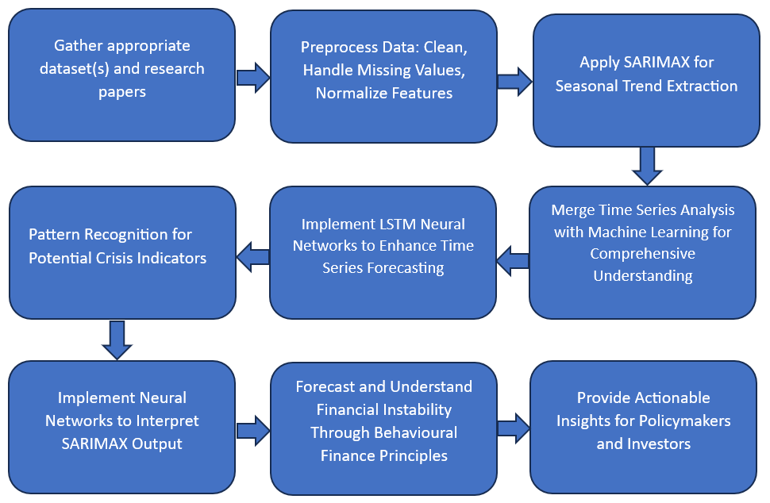
Proposed Methodology

Slide 10
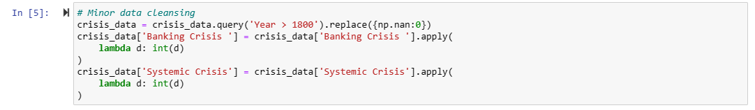
Exploratory Data Analysis
Minor data cleaning operations on the crisis_data DataFrame.
It uses the query() function to filter the data
Replaces NaN values with 0
Converts the columns 'Banking Crisis' and 'Systemic Crisis' to integer data types using the apply() function with a lambda expression.

Slide 11
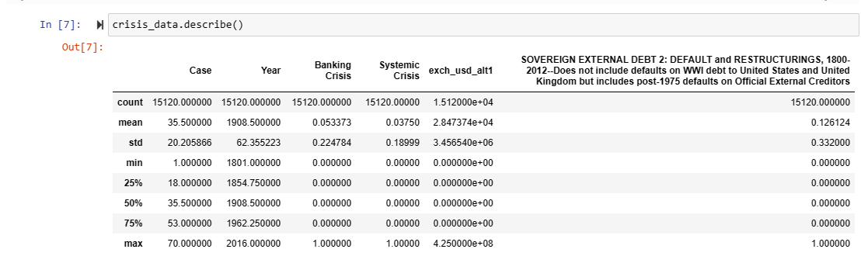
Exploratory Data Analysis
Output of the describe() function, which provides descriptive statistics for the numerical columns in the crisis_data DataFrame.
It includes the count, mean, standard deviation, minimum, percentiles, and maximum values for columns such as 'Year', 'Banking Crisis', 'Systemic Crisis', and others related to financial measures.

Slide 12
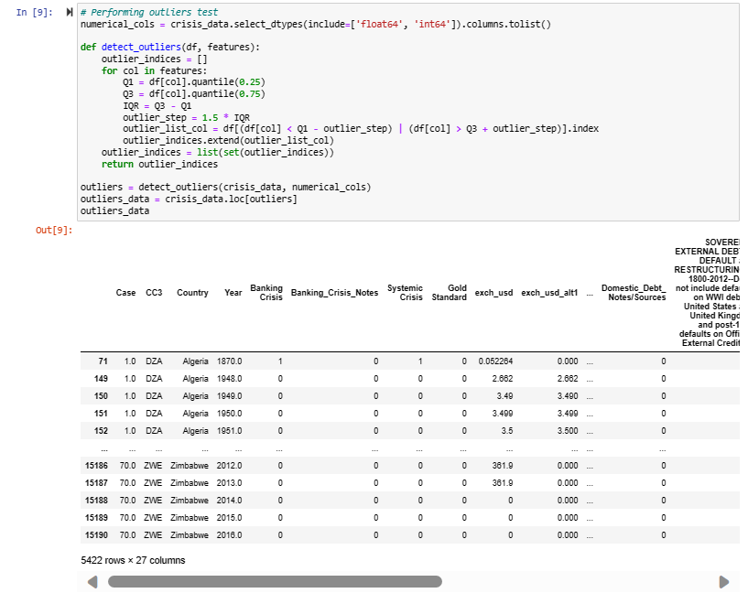
Exploratory Data Analysis
Identifies outliers within the provided DataFrame columns based on the interquartile range (IQR) method.
The function calculates the first (Q1) and third (Q3) quartiles, computes the IQR (Q3 - Q1), and identifies outliers as those values that fall below Q1 - 1.5 * IQR or above Q3 + 1.5 * IQR.
The output shows a subset of crisis_data where the outliers have been extracted, indicated by rows with unusual values in comparison to the rest of the dataset.

Slide 13
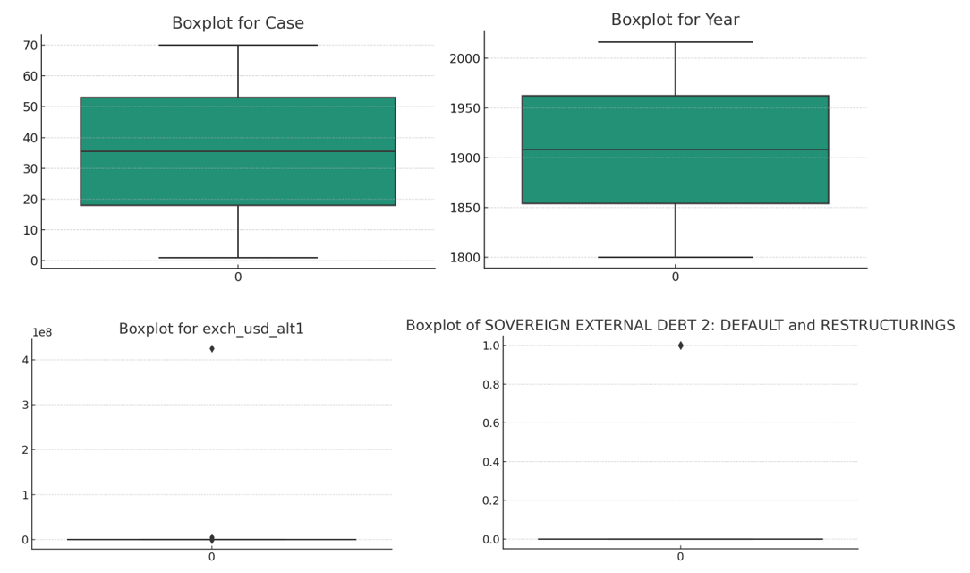
Exploratory Data Analysis
1. Case: The median is 35.5 with an interquartile range (IQR) of 35, and there are no outliers.
2. Year: The median year is 1908 with an IQR of 108 years, and there are no outliers.
3. exch_usd_alt1: The median exchange rate is approximately 0.41 with an IQR of about 3.64, and there are outliers present. There are 561 outliers with values ranging significantly from 9.14 to 425,000,000. This suggests extreme variability and instances of exchange rates that are far from the typical range.
4. SOVEREIGN EXTERNAL DEBT 2: The median is 0 with an IQR of 0, indicating most values are zero or close to zero, but there are outliers present. There are 1907 outliers, all with a value of 1.0. This indicates that the instances of default or restructurings are quite common as outliers, as the median of the data is 0, which likely represents no default/restructuring.
Generates boxplots for numerical columns in the crisis_data DataFrame

Slide 14
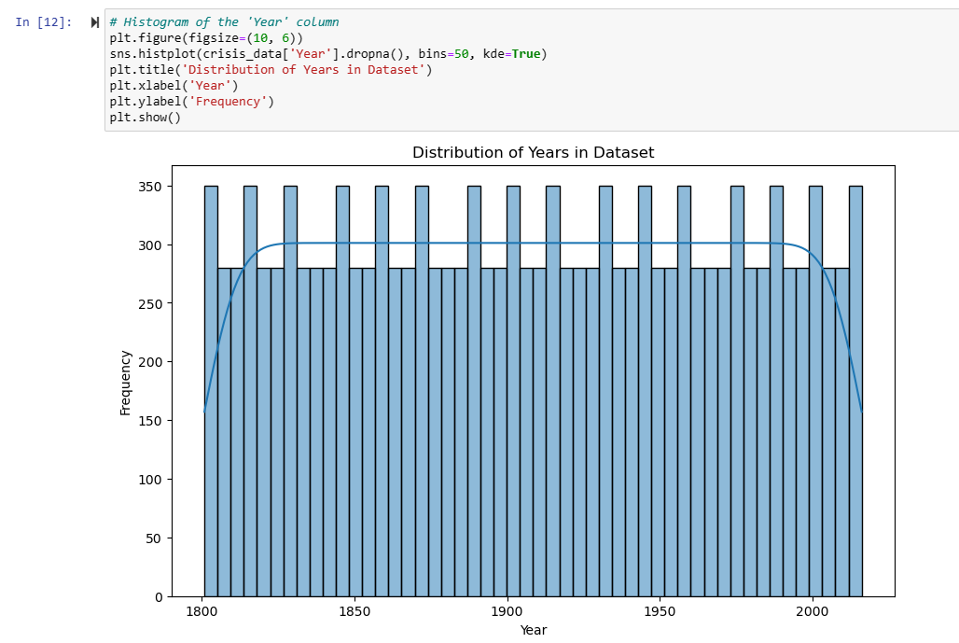
Exploratory Data Analysis
Generated a histogram with a kernel density estimate (KDE) overlay for the 'Year' column of the crisis_data DataFrame, showing the distribution of years and their frequency within the dataset. It is normally distributed.

Slide 15
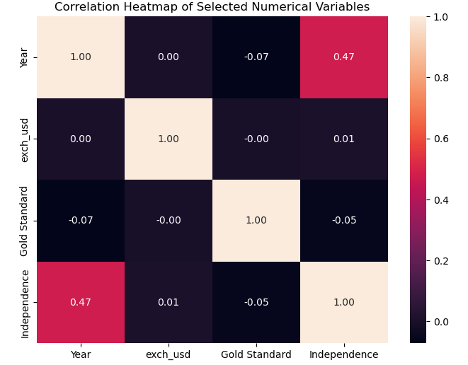
Exploratory Data Analysis
Year and Independence: Moderate positive correlation (0.47), hinting at increasing independence events over time.
Year with exch_usd/Gold Standard: Negligible correlations, indicating no relationship.
exch_usd and Gold Standard: Zero correlation, no apparent relationship.
exch_usd and Independence: No correlation, suggesting no direct link.
Gold Standard and Independence: Very weak negative correlation, likely insignificant.
Self-Correlations: Variables perfectly correlate with themselves.

Slide 16
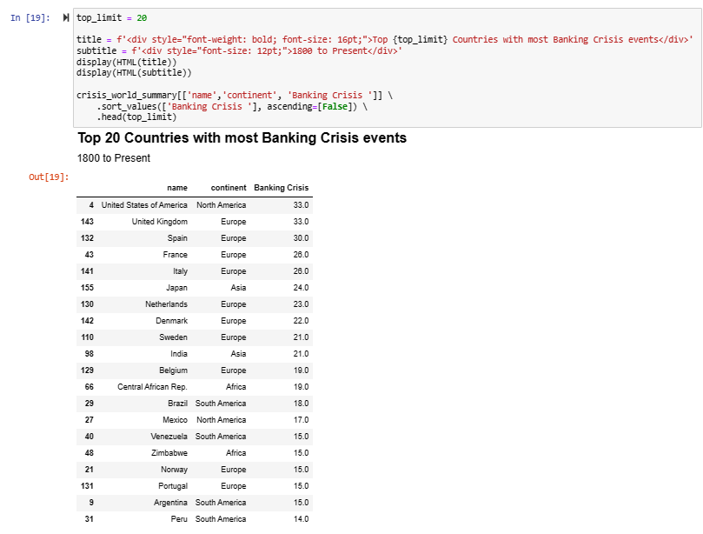
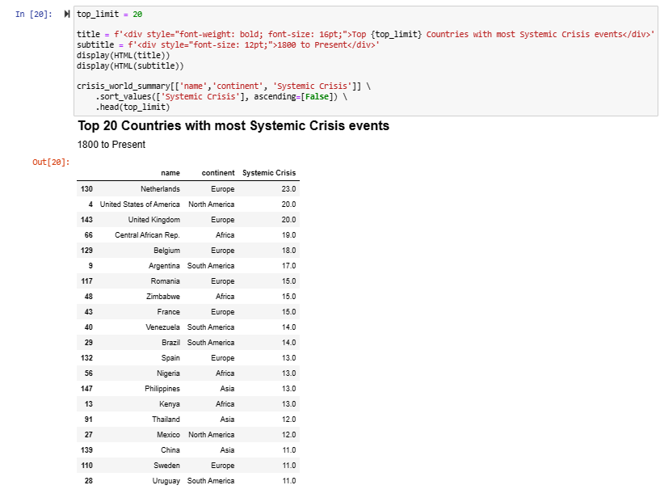
Exploratory Data Analysis
Sorted the crisis_world_summary DataFrame to identify the top 20 countries with the most banking crisis events from 1800 to the present.
Sorted the crisis_world_summary DataFrame to identify the top 20 countries with the most systemic crisis events from 1800 to the present

Slide 17
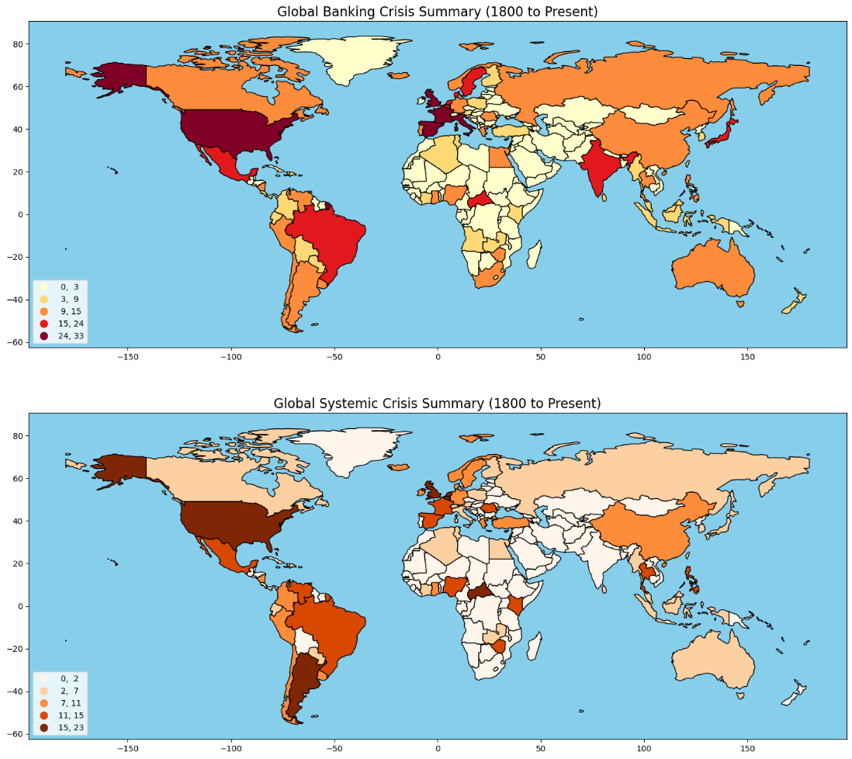
Exploratory Data Analysis
The first plotted map summarizes global banking crisis events from the 1800s till present day
The second plotted map summarizes global systemic crisis events from the 1800s till present day
'fisher_jenks' scheme was used for data classification, and to display a legend on the lower left corner

Slide 18
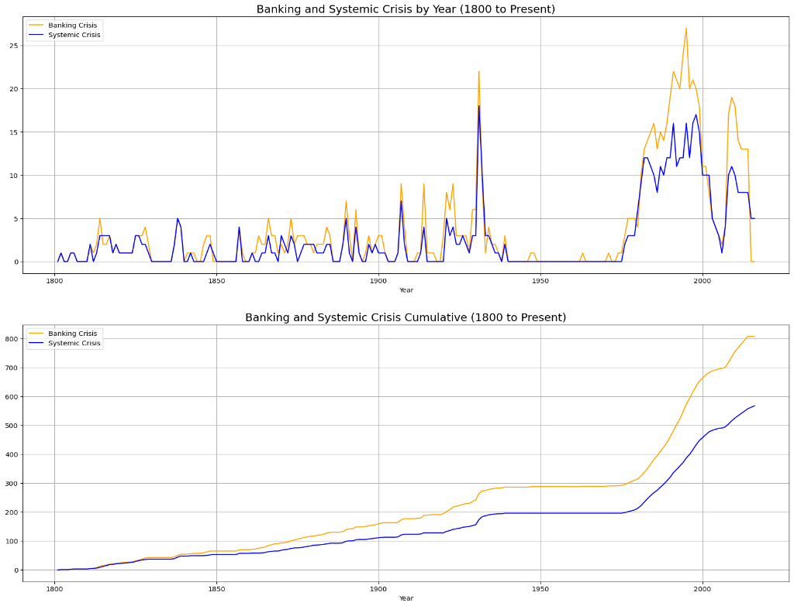
Exploratory Data Analysis
The first line plot shows the annual count of banking and systemic crises from the 1800s till present
The second line plot shows the cumulative count of these crises from the 1800s till present

Slide 19
Next Step of Research Focus
To enhance the research's predictive capacity:
Apply SARIMAX for seasonal trends and external influence analysis.
Use LSTM neural networks for pattern recognition in time-series data.
Experiment with hybrid LSTM-SARIMAX models for capturing both seasonal patterns and complex temporal sequences.
Develop hybrid models combining SARIMAX's precision and LSTM neural networks' learning prowess for accurate crisis forecasts.

Slide 20
Conclusion
Analyzed historical financial crises, highlighting most affected countries.
Utilized visualizations to discern trends and correlations.
Summarized annual and cumulative crisis data for insight.
Mapped crisis distribution, indicating global financial vulnerabilities.
Prepared a base for predictive modeling of financial crises.

Slide 21
References : APA format
Harvard Business School. (2018). 2018 Financial Risk and Regulation Survey: Behavioral Finance & Financial Stability.
Tekin, H. (2020). How optimal cash changed by the global financial crisis?. Economics and Business Letters, 9(2), 114-123.
World Bank. (2020). Global Financial Development Report 2019/2020: Bank Regulation and Supervision a Decade after the Global Financial Crisis.
Lajili, K., Li, T. M., Chourou, L., Dobler, M., & Zéghal, D. (2023). Corporate risk disclosures in turbulent times: An international analysis in the global financial crisis. Journal of International Financial Management & Accounting.
Shehzad, K., Xiaoxing, L., & Kazouz, H. (2020). COVID-19’s disasters are perilous than Global Financial Crisis: A rumor or fact?. Finance Research Letters, 36.
Lolea, I.-C., Petrariu, I.-R., & Giurgiu, A. (2021). ARIMA vs. MACHINE LEARNING IN TERMS OF EQUITY MARKET FORECASTING. The Annals of the University of Oradea. Economic Sciences, XXX(2), 299-308.
Tang, Y. M., Chau, K.-Y., Li, W., & Wan, T. W. (2020). Forecasting Economic Recession through Share Price in the Logistics Industry with Artificial Intelligence (AI). Computation, 8(3).
Liu, J., Yan, R., & Zhang, Y. (2023). Stock Market Forecasting Using the ARIMA GARCH and Random Forest Model During The Russia–Ukraine War. Applied Economics and Policy Studies book series (AEPS), Springer.
Zulkefly, R. N., Karim, A. A., Rahman, A. A., & Sarmidi, T. (2020). Financial inclusiveness and economic growth: New evidence using a threshold regression analysis. Economic Research-Ekonomska Istraživanja, 33(1), 1465-1484.
Hossain, M. J. (2023). Comparative Analysis of ARIMA SARIMAX and Random Forest Models for Forecasting Future GDP in Relation to Unemployment Rate.

